Slide 1
Daniel W Cohn
September 2022
Gender differences in pre-clinical models of Chemotherapy Induced Neuropathy

Slide 2


From pre-clinical to clinical
Different factors could play a role in preventing proper translation from pre-clinical to clinical studies, thus explaining why drug candidates that were successful in pre-clinical studies fail when moved to clinical trials.
In vivo pre-clinical
Clinical
Lack of robust non-evoked pain endpoints
Lack of translatable Biomarkers
Lack of studies taking gender differences into account

Slide 3
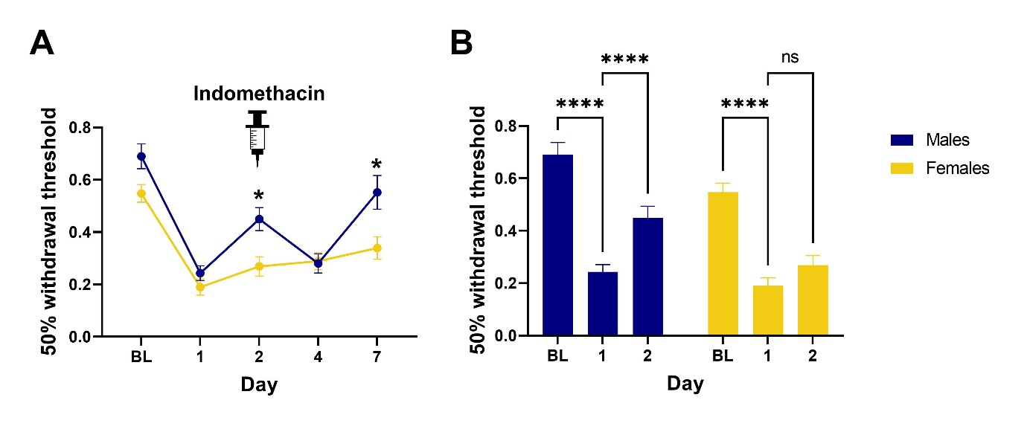
UVB in male vs female mice
We reported, in a previous newsletter, how gender can influence data obtained in the inflammatory pain model of Ultraviolet B radiation exposure. Treatment with indomethacin improved mechanical allodynia in males but not in females.
Systemic indomethacin treatment effect on UVB-induced inflammatory pain. Mice received indomethacin (10mg/kg) on Day 2 after UVB irradiation. Male animals’ pain withdrawal thresholds improved 2h after the dosing, showing that the traditional anti-inflammatory drug is effective in alleviating sunburn pain. Female mice, on the other hand, have no significant change in their sensitivity thresholds. A. Comparison of males and females at baseline (BL) and on each test day. There was a significant Sex-Day interaction (F_{4,168} = 2.668, p=0.0341). Males differed from females at Day-2 (t_{38.89}=3.149, p=.0154) and Day-7 (t_{2.751}=35.37,p=.0456). B. For each sex, improvement with indomethacin compared to Day-1 following UVB. The main effects of Sex (F_{1,42}= 13.14, p=.0008) and Day (F_{1.694,71.15} = 70.99, p<.0001) were significant. Improvement on Day-2 was significant for males (t₂₀=5.680,p<.0001) but not females (t₂₂=1.831,p=0.1548).

Slide 4
Oxaliplatin in male vs female mice
When oxaliplatin, a platinum based chemotherapeutic agent, is given systemically to mice, there is a non significant trend towards female mice showing greater mechanical allodynia response. Systemic Duloxetine, at a dose of 30 mg/kg, determined improvement for males but not for female animals.
Systemic treatment with oxaliplatin (10 mg/kg, ip on day 0) induced decreased paw withdrawal threshold (PWT) values in male and female mice. Mice from the duloxetine groups, were treated daily from day 1 to day 5 (30 mg/kg po). In groups treated with duloxetine, male animals’ paw withdrawal thresholds showed statistically significant improvement on assessments at day 3 when compared to females (p<0.001). Also, when comparing male animals treated with duloxetine on day 3 against male animals treated with vehicle on the same day a statistically significant difference was detected (p<0.0001). 3-Way ANOVA showed a main effect of Time (F(2,169)=112.1; p<0.0001), Treatment (F(1,169)=33.55; p<0.0001) and Gender (F(1,169)=10.47; p<0.001). There was a significant interaction between Time x Gender (F(2,169)=4.904; p<0.01) , but no significant interaction between Treatment x Gender (F(1,169)=2.466; p=0.1182) or among Time x Treatment X Gender (F(2,169)=0.9625; p=0.384 .

Slide 5
Conclusions
Both males and female mice developed neuropathy after oxaliplatin
Von Frey Test (mechanical allodynia):
  time- course was similar for both genders
  There is a trend towards female animals showing greater sensitivity
  In the present experimental conditions, duloxetine showed analgesic effect
    for male but not for female mice

